Slide 1

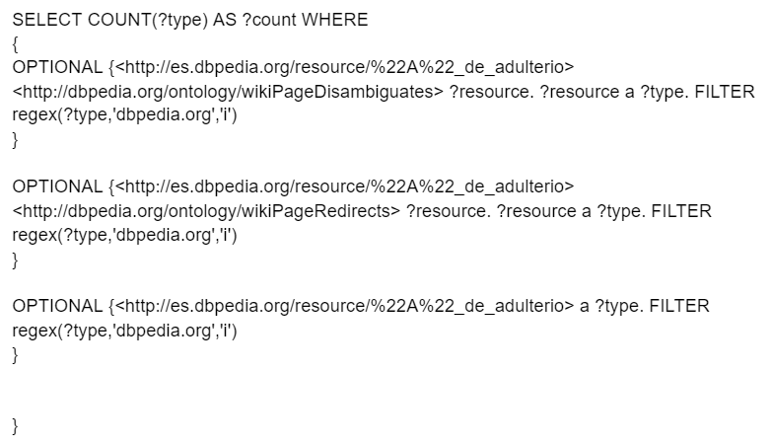
URLs validation problem
URLs validation problem has been solved
If URL is not found in either instance types or redirects or disambiguations Dbpedia datasets, it does not exist and will return 0 types. In that case the URL is counted as invalid
SPARQL query to check each URL of uriCounts file

Slide 2
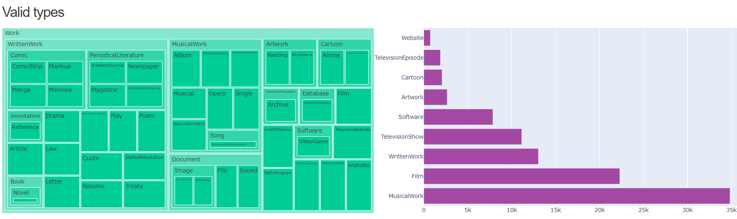
DASHBOARD DRAFT: TYPES
Types of Spanish valid URLs according to DBpedia hierarchy
Treemap chart
Bar chart

Slide 3
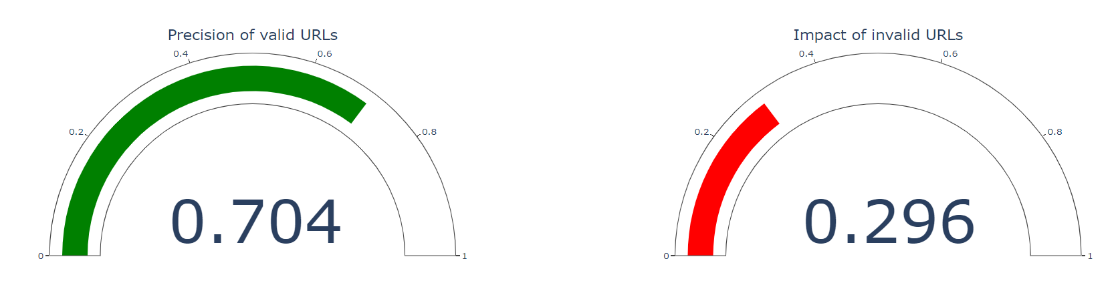
DASHBOARD DRAFT: Some statistics
Precision and Impact of Spanish URLs
Precision = valid URLs / total URLs
Impact = invalid URLs / total URLs

Slide 4
NeXT STEPS
URLs validation of uriCounts file for English -> In progress (executing)
Get types of valid English URLs -> In progress (executing)
Calculate precisión and impact of English URLs -> In progress (executing)
Think about other statistics to show in Spotlight Dashboard

